Slide 1
Module 6
GNU Octave as a Data Science Tool

Slide 2
GNU Octave as a Data Science Tool
GNU Octave is a free-source application with a high-level programming language.
It is used to create various mathematical algorithms with its language.
GNU Octave provides numerous built-in functions that ease the task of performing numerical calculations.
It is primarily designed for matrix calculations such as decoding simultaneous equations, calculating eigenvalues and eigenvectors, etc.
As GNU Octave possesses its programming language, it can present the data in many different ways.
In the data science domain, GNU Octave is used to create and test numerical algorithms

Slide 3
Vectors and Matrices
Vectors
Numeric calculations normally consist of operating with number sequences. Such sequences of numbers are called arrays, but in GNU Octave, they are treated as a kind of vectors. A vector can be stated as a 1 × 1 matrix that encloses a number list.
GNU Octave provides us with various ways to define a vector. Mostly, they are defined using the square brackets “[ ]”.
A row vector is defined by separating the numbers enclosed in the square brackets by spaces or commas.
Similarly, a column vector is defined by separating the numbers enclosed in the square brackets by semicolons.

Slide 4
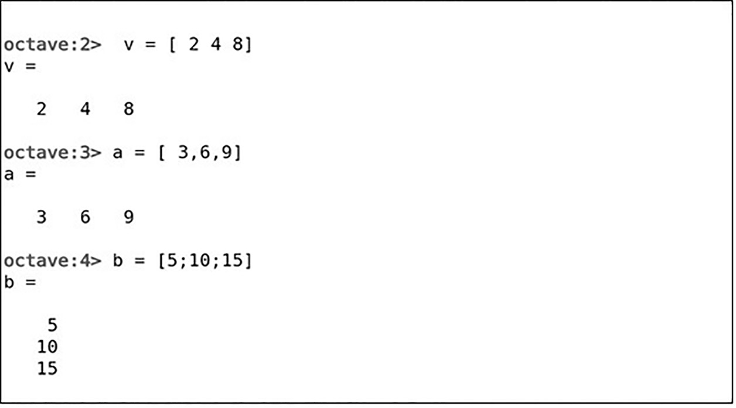
Vectors
Vectors

Slide 5
Vectors
You can also create a vector of counting numbers using a colon “:”
To create such a vector, define a range separated by a colon and enclosed in square brackets.
You can also specify the increment factor within the range.
Note that if a negative increment factor has to be given, the range should be given in a descending manner.

Slide 6
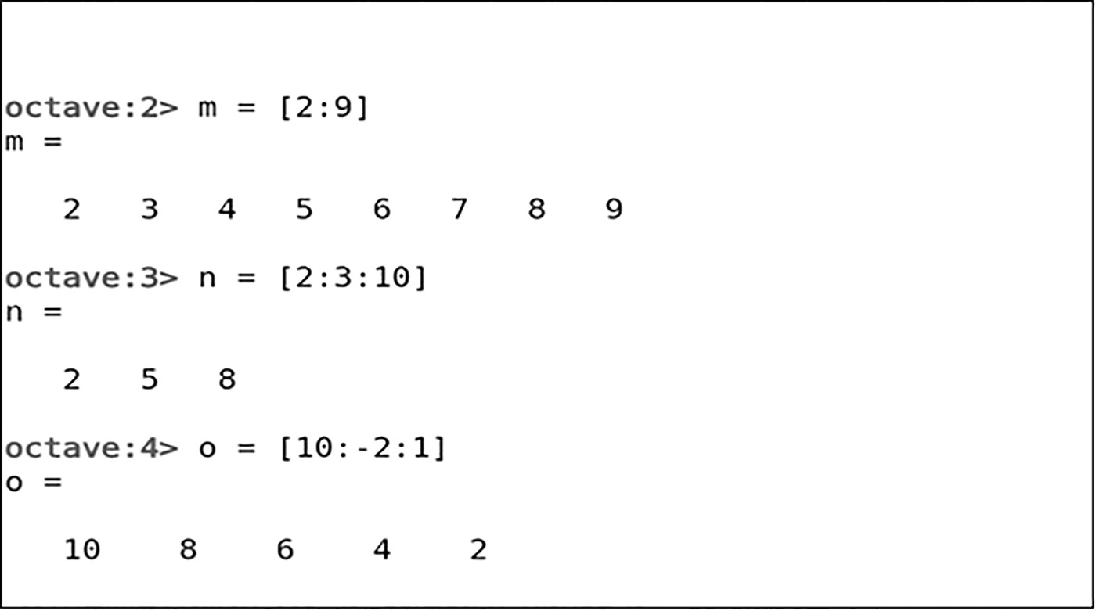
Vectors
Vectors

Slide 7
Vectors
GNU Octave also has some in-built functions to create vectors. These functions can be used to create a null matrix, an evenly spaced vector, and much more. They are as follows:
1. linspace (a1, a2, N) – This function creates a vector from a1 to a2 by evenly separating N elements in the vector. A vector is created starting from 1 to 5, and all the elements are evenly placed to create a vector with six elements.
Octave:> linspace (1,5,6)
Output:
ans =
1.0000 1.8000 2.6000 3.4000 4.2000 5.0000
Octave:> linspace (2,4,6)
Output:
ans =
2.0000 2.4000 2.8000 3.2000 3.6000 4.0000

Slide 8
Vectors
2. logspace (a1, a2, N) – This function creates a vector from 10^{a1} to 10^{a2} by logarithmically separating N elements in the vector. A vector is created starting from 10¹ to 10⁵, and all the elements are logarithmically placed to create a vector with six elements.
Octave:> logspace (1, 5, 6)
ans =
1.0000e+01 6.3096e+01 3.9811e+02 2.5119e+03 1.5849e+04 1.0000e+05

Slide 9
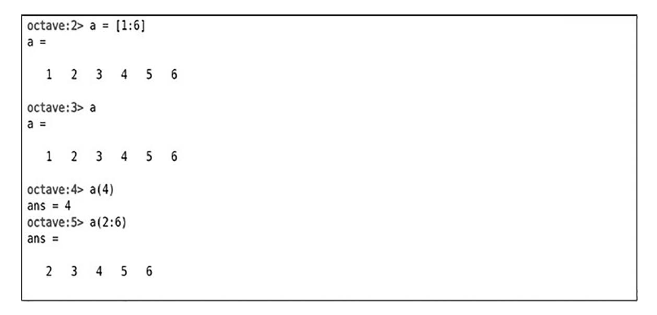
Vectors
Extracting element:
You can display the vector by just entering the vector name and extract the elements of the vector by enclosing the element_index in the round brackets ().
To extract a range of elements, use the colon notation.

Slide 10
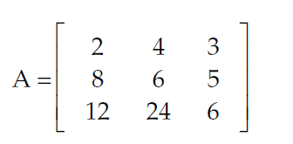
Matrices
Matrices are the rectangular array elements and are represented to be in size m × n, where m and n represent the number of rows and columns, respectively.
There are several ways to create a matrix in GNU Octave.
You can create a matrix using the same syntax as that of a vector just defining the row in different rows.

Slide 11
Matrices
Another way to create a matrix is by using the semicolon notation. Enclose the entire matrix in the square brackets and separate the rows using semicolons.
GNU Octave provides us with a way to create a matrix using the range of values, i.e., using the colon notation. Various ways of the colon notation can be used at different rows.
Octave:>a=[1 2 3
4 5 6]
Ouput:
a=
1 2 3
4 5 6
Octave:> b=[7 8 9;-1 -2 -3;11 12 13]
Ouput:
b =
7 8 9
-1 -2 -3
11 12 13
Octave:> c=[2:4;5:2:10;-6 -5 -4]
Output:
c =
2 3 4
5 7 9
-6 -5 -4

Slide 12
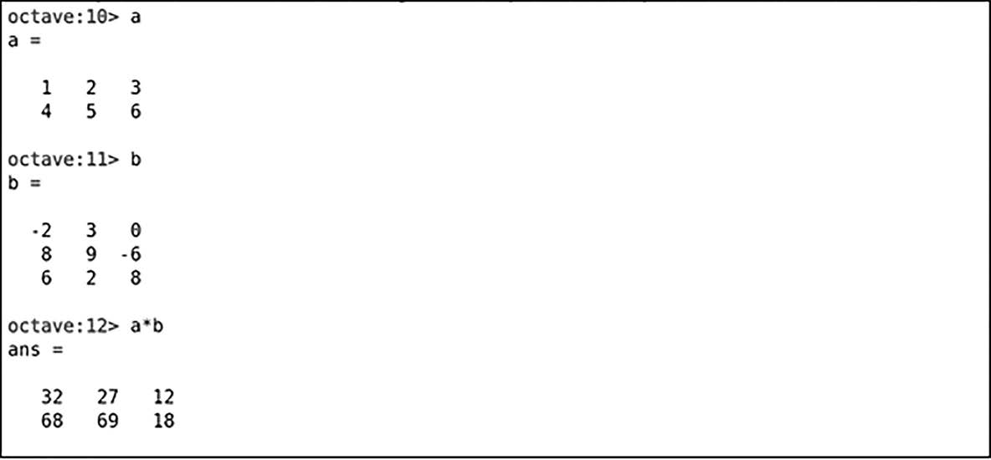
Matrix Multiplication
For matrices and vector multiplication, the * symbol is used to represent the multiplication.
In matrix multiplication, it is important to remember that the matrices can be multiplied only if they are compatible with each other. Compatible matrices are the matrices in which the number of columns of the first matrix matches with the number of rows of the second matrix. Matrix a and matrix b are compatible with each other and thus can be multiplied.

Slide 13
Matrix Multiplication error
Octave:>a=[1 2 3
4 5 6]
Octave:> b=[7 8 9
1 2 3]
Octave:> a*b
Output:
error: operator *: nonconformant arguments (op1 is 2x3, op2 is 2x3)
However, the matrices defined cannot be multiplied as the number of columns of the matrix (i.e., 3) is not equal to the number of rows in matrix c (i.e., 2).
The Octave prompt will throw an error when such matrices are requested to be multiplied.

Slide 14
Transpose of a Matrix
A transposed matrix is a matrix whose original rows and columns are inter-changed with one another.
Usually, the transposed matrix is represented as S^{T}.
In GNU Octave, apostrophe (‘) is used to transpose a matrix.
GNU Octave provides various in-built functions that can be used for matrix manipulation.

Slide 15
Transpose of a Matrix
Octave:>a=[1 2 3
4 5 6]
Octave:> a’
Output:
ans =
1 4
2 5
3 6

Slide 16
Matrix Manipulation
zeros (M, N) – This function creates a matrix of size M × N which consists of every element as a zero.
ones (M, N) – This function creates a matrix of size M × N which consists of every element as one.
eye(N) – This function creates an identity matrix of size N × N. An identity matrix is a matrix whose diagonal elements are 1, and all other elements are 0.

Slide 17
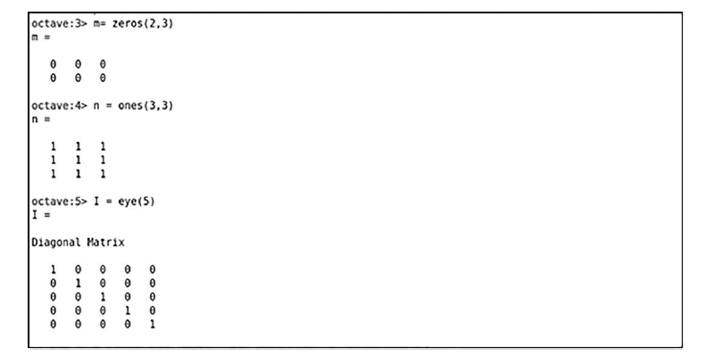

Slide 18
Matrix Manipulation
Some other functions that can be used for matrix manipulation are as follows:
rand() – This function creates a matrix that consists of random numbers.
diag() – This function creates a diagonal matrix. It is also used to extract diagonal elements of a matrix.
inv() – This function creates an inverse of that particular matrix.
eig() – This function calculates the eigenvectors and eigenvalues of a matrix.
det() – This function is used to calculate the determinant of a matrix.

Slide 19
Arithmetic Operations
GNU Octave provides various functions that are used to perform various arithmetic operations on vectors or matrices. Many functions ease the user’s job to perform arithmetic operations.
Some of the functions used are as follows: exp(x), pow2(x), pow2(f, x), sqrt(x)
1. exp(x) – This built-in function creates a vector/matrix which consists of the exponential of every element in the vector/matrix x, i.e., it calculates e^{x} for all the elements in x
Octave:> x=[1 2 3 4]
exp(x)
Output: x =
1 2 3 4
ans =
2.7183 7.3891 20.0855 54.5982

Slide 20
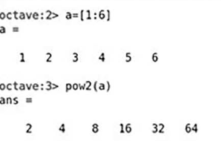

Arithmetic Operations
2.pow2(x) – This function creates a vector/matrix that consists 2^{x} of the elements in the vector/matrix x. For example, the result is the interpretation of [2¹, 2², 2³, 2⁴, 2⁵, 2⁶].
3.pow2(f, x) – This function is similar to the pow2() function. Here, f is multiplied to all the elements in the pow2(x) function. Mathematically, it can be represented as f*(2x)

Slide 21
Arithmetic Operations
sqrt(x) – As the name suggests, this function calculates the square root of all the elements in the vector/matrix x
Octave:>x=[1 2 3 4]
sqrt(x)
Output: ans =
1.0000 1.4142 1.7321 2.0000

Slide 22
Trigonometric functions
abs(x) – This function returns the absolute values of all the elements in the vector/matrix x. All the negative values are replaced as the absolute values.
Octave:> x=[1 -2 3 -4]
abs(x)
Output:x =
1 -2 3 -4
ans =
1 2 3 4

Slide 23
Trigonometric functions
sin(x) – This function returns the sine value of all the elements in the vector/matrix x in radians.
Octave:> x=[1 2 3 4]
abs(x)
Output:ans =
0.8415 0.9093 0.1411 -0.7568
sind() – This function returns the sine value of all the elements in the vector/matrix x in degrees
Octave:> x=[1 2 3 4]
abs(x)
Output:ans =
0.017452 0.034899 0.052336 0.069756
Similarly, you can also calculate all trigonometric values such as cosine, sec, tan, etc. in GNU Octave.

Slide 24
Trigonometric functions
rad2deg() – This function converts the given value in radians to degree format.
Octave:> x=[1 2 3 4]
rad2deg(x)
Output:ans =
57.296 114.592 171.887 229.183
deg2rad() – This function converts the given value in the degree format to radians format
Octave:> x=[1 2 3 4]
deg2rad(x)
Output:ans =
0.017453 0.034907 0.052360 0.069813
GNU provides a lot of such built-in functions that make it easy to perform arithmetic operations in GNU Octave.

Slide 25
Set Operations
GNU Octave has many functions to manage huge datasets. A set is nothing but a collection of distinctive elements of a vector or a matrix.
A vector or a matrix can be converted to a set just by removing the duplicate values using the unique function.
Moreover, it is not mandatory to use the unique function as all the set functions in GNU Octave removes the duplicate values before operating.
unique(x) – This function removes all the duplicate values of the vector/matrix x.
union(M, N) – This function merges both the set M and N. Note that duplicate values are not included in the union of the set.
intersect(M, N) – This function extracts the common elements from both the set M and N. Note that duplicate values are not included in the intersection of the set
setdiff(M, N) – This function returns a set containing elements that are present in set M and does not exist in set N.
setxor(M, N) – This function returns a set containing all the elements from set M and set N except the common elements.
ismember(M, N) – This function returns a logical matrix containing 1 and/or 0. M is a set and N can be a number or a set of values. If the number is present in matrix M, it will place 1 or otherwise 0. The resultant matrix is of the same size as that of set M.

Slide 26
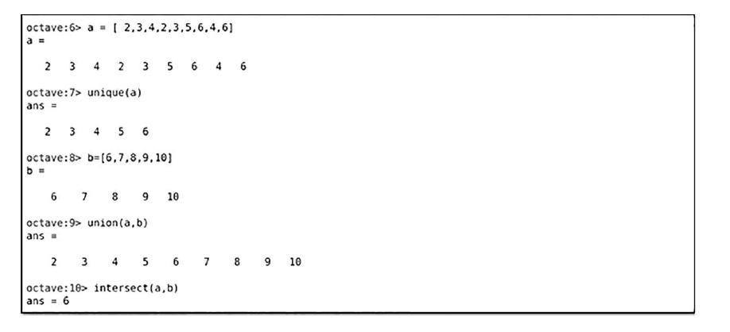
Example of the union and intersection of the set.

Slide 27
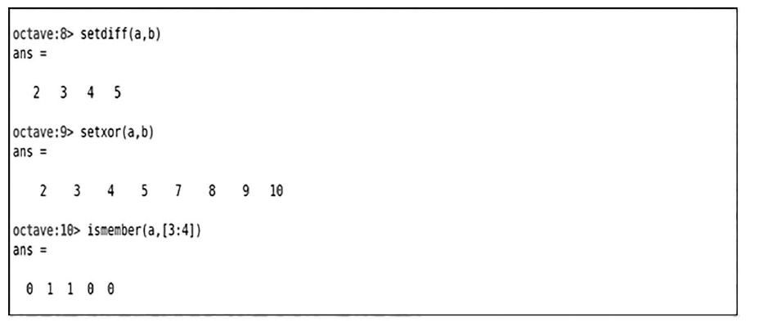
Example of the union and intersection of the set.

Slide 28
Plotting Data
The most basic plot in GNU Octave is created using the plot() function provided by GNU Octave.
The plot() function takes the two inputs, i.e., the cartesian values x and y, and plots the graph.
We can add specifications to the graph by adding the title to the plot, the axis label, style of the plot, and much more.
Octave:
1> x = 0:0.1:2*pi;
y = sin(x);
plot(x, y, "*r", "markersize", 2); xlabel("x");
ylabel("y = sin(x)"); title("Basic plot example");

Slide 29
Plotting Data
In this plot, we have used the “*” marker, but GNU Octave provides many marker options. The marker size is the size of the marker.
You can modify your plot according to the requirements of the user
The format arguments that can be used within the plot() function are given as below:
Linestyle:
“-”– Solid lines
“.”– Dotted lines
“--” – Dashed lines
“-.” – Dash-dotted lines

Slide 30
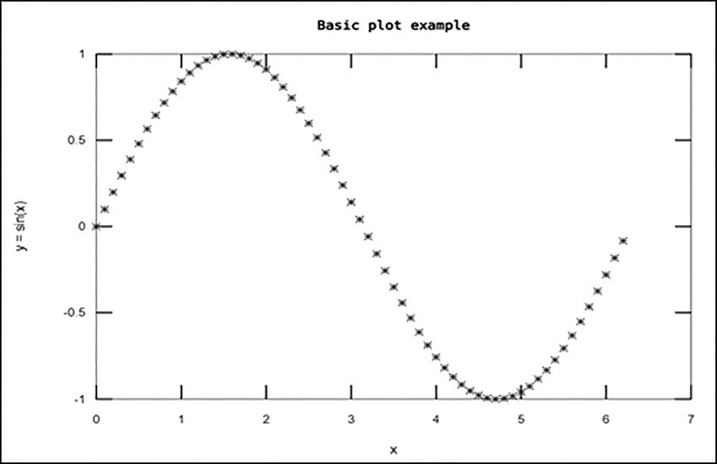
Plotting Data

Slide 31
Plotting Data
Marker:
“+” – Crosshair
“*” – Star
“×” – Cross
“d” – Diamond
“v”– Downward-facing triangle
“<” – Left-facing triangle
“h” –Hexagram
“o” – Circle
“.” – Point
“s” – Square
“^” – Upward-facing triangle
“>” –Right-facing triangle
“p” – Pentagram

Slide 32
Plotting Data
Color:
“k” – Black
“b” – Blue
“y” – Yellow
“c” – Cyan
“r” – Red
“g” – Green
“m” – Magenta
“w” – White

Slide 33
Plotting Data
Pie Charts
Pie charts are often used to show the data proportions in the data, i.e, the contribution of a particular category in a set of data.
In GNU Octave, a pie chart is created using the pie function.
The syntax of the pie() function is as follows:
Syntax: pie(x, explode, labels)
Attributes:
x – x is the vector based on which the pie chart is plotted. Here, the size of the slice is calculated based on the percentage it contributes to the total data.
explode – explode is a vector of the same size as that of the input vector x, and it contains elements as 0(zero) or any nonzero element. A nonzero element represents that slice of the pie to be exploded.
labels – The label cell array represents the label to each slice.

Slide 34
Plotting Data
Octave:2>
pie ([17, 52, 41,28,2], [0,3,0,0,0], {"Action", "Sci-Fi", "Drama", "Romance", "Comedy"});
title ("Pie Chart for Favorite Movies")
In the above example, a pie chart for favorite movies is created using the pie() function. You can see that the “Sci-Fi” slice of the pie is exploded as specified in the explode vector.
One important factor to remember in a pie chart is the missing slice.
When the sum of all the elements in a vector is less than 1 (sum < 1) and such vector is given as an input vector to the pie() function, in such cases, the Octave would not calculate the percentage proportion for each slice; it will use the vector elements itself to proportionate the data, leaving a missing slice for the part of the data that is undefined.

Slide 35
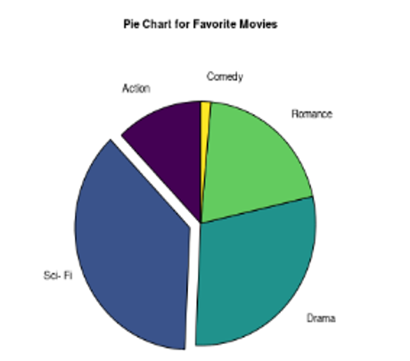
Plotting Data

Slide 36
Plotting Data
Octave:3>
pie ([0.17,0.61,0.2], {"Coffee", "Tea", "Milk"});
title ("Pie Chart for Beverage Preferences")
In the above example, you can see that the input vector contains three elements – 0.17, 0.61, and 0.2. The sum of these elements is 0.98 (0.98 < 1).
So here, Octave does not calculate the sum and the respective percentages and considers the elements to be taken in percentages and keeps a missing slice at the last.

Slide 37
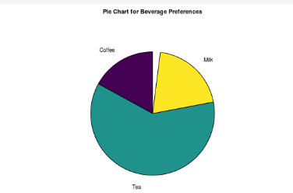
Plotting Data

Slide 38
Scatter Plot
In GNU Octave, a scatter plot is created using the scatter() function. The syntax of the scatter() function is given as the following:
Syntax: scatter (x, y, s, c, style, “filled”)
Attributes:
x, y – x and y are the vectors that are used to plot the markers.
s – s is the marker size. It is computed as sqrt(s). The default value of s is 36 sq. points.
c – c represents the color of the marker. The notations for the different colors are mentioned above in the format arguments.
style – style represents the shape of the marker. The notation for various styles of the marker is covered in the format arguments.
“filled” – If this attribute is specified, the marker will be filled or else it will be a hollow marker

Slide 39
Scatter Plot
Octave:
4>1x = randn (100, 1);
y = randn (100, 1);
scatter (x, y, "m", "d", "filled"); title ("Scatter() Plot");

Slide 40
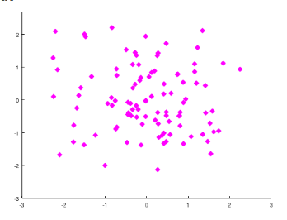
Scatter Plot

Slide 41
Histogram
In GNU Octave, the histogram is created using the hist() function.
The hist() function mainly needs one input which is the Y-values vector. Other property parameters can be included or excluded as per the require- ments of the user. If the number of bins to be considered is not specified by the user, by default, Octave generates ten bins
Let’s create a histogram.
Octave:
5>1A = hist (randn (10000, 1), 30); xlabel ("Value");
ylabel ("Count"); title ("Histogram");

Slide 42
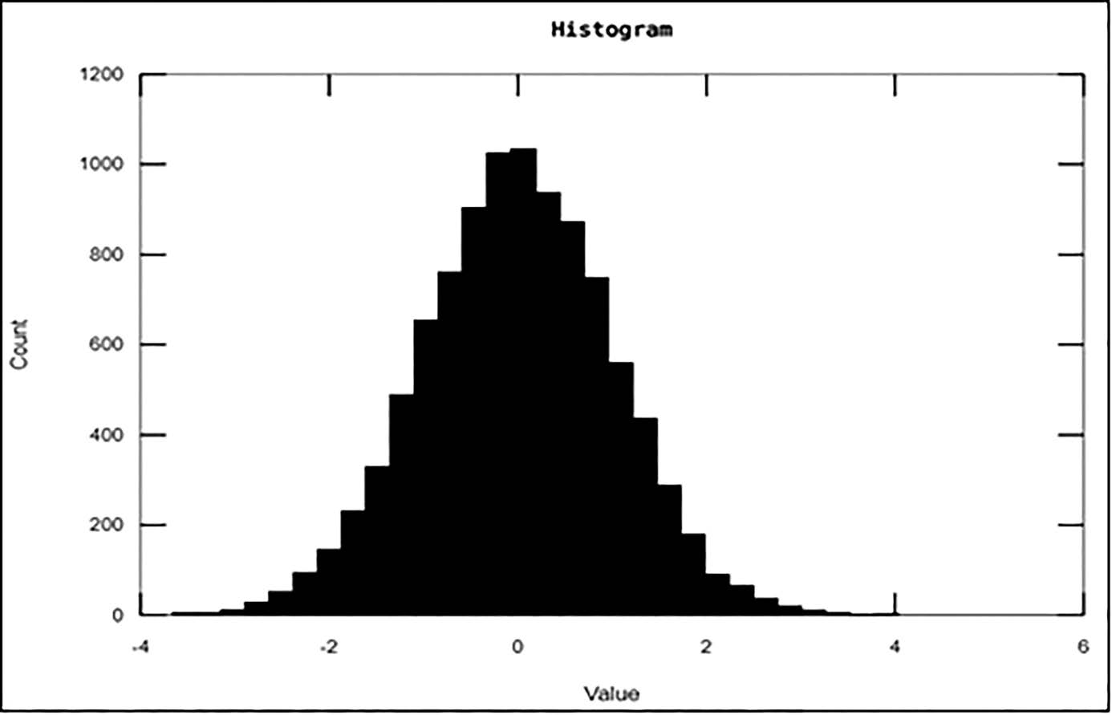
Histogram

Slide 43
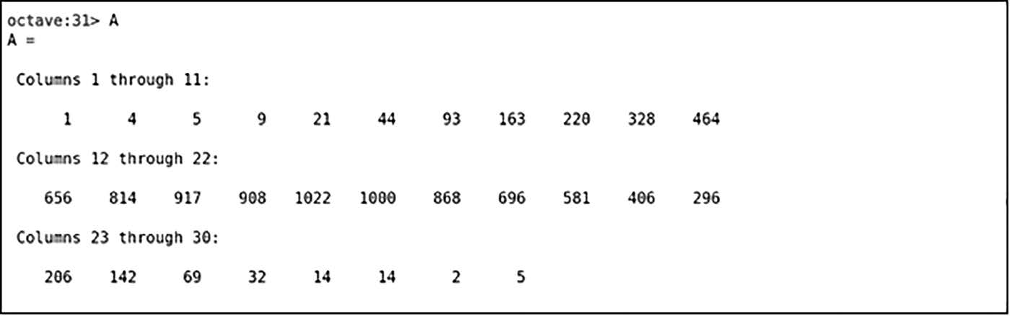
Histogram

Slide 44
Histogram
The hist() function is assigned to array A.
This is carried out to store the number of elements in every bin.
As we had given the input to create 30 bins, in the above figure, you can see that the array consists of 30 elements, and each element represents the number of items stored in that particular bins.
The addition of these elements will sum up to 10,000 as we had generated 10,000 random numbers to create the histogram

Slide 45
Histogram
Summary:
GNU Octave is profoundly used for numerical computations as numerical computations and vector/matrices go hand in hand.
Studied various techniques to create a vector and extract the elements of the vector.
Looked at a few built-in functions to create vectors.
Study many ways to create matrices and built-in functions to manipulate it.
GNU Octave provides multiple built-in functions for arithmetic operations. These arithmetic operations are highly beneficial as they ease out the process and cut down the lines of code to just a single-line function.
GNU Octave also provides functions to perform set operations such as the union and intersection of sets.

